Slide 1
Interview Exercises
UI Business Components (slides 2 - 6)
API Design (slides 7 - 9)

Slide 2
Break web pages into UI business components
Definitions
UI business component is a meaningfully grouped UI section that may or may not be re-usable and defines data elements, behavior via actions, ability for other business components to act based on notifications and content / page configuration.
Instructions
Review examples on slides 3 and 4
Model pages on slides 5 and 6
Break both pages into components (per example on slide 3)
Take 1 component from each page to draft component definitions (per example on slide 4)

Slide 3
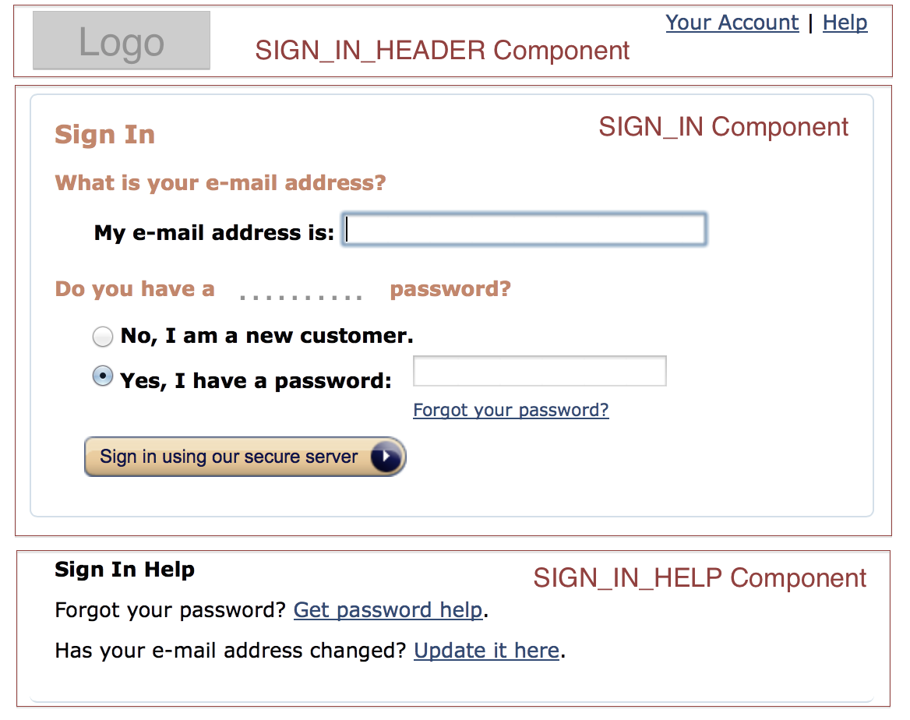
Example Page break-up into components

Slide 4
Name: SIGN_IN Data: email_address customer_relationship_type password Actions: sign_in retrieve_password Configuration (content, images, etc.): sign_in_header email_address_question_label email_address_label password_question_label new_customer_relationship_label password_label retrieve_password_label sign_in_label
Example (cont’d) Component definition

Slide 5
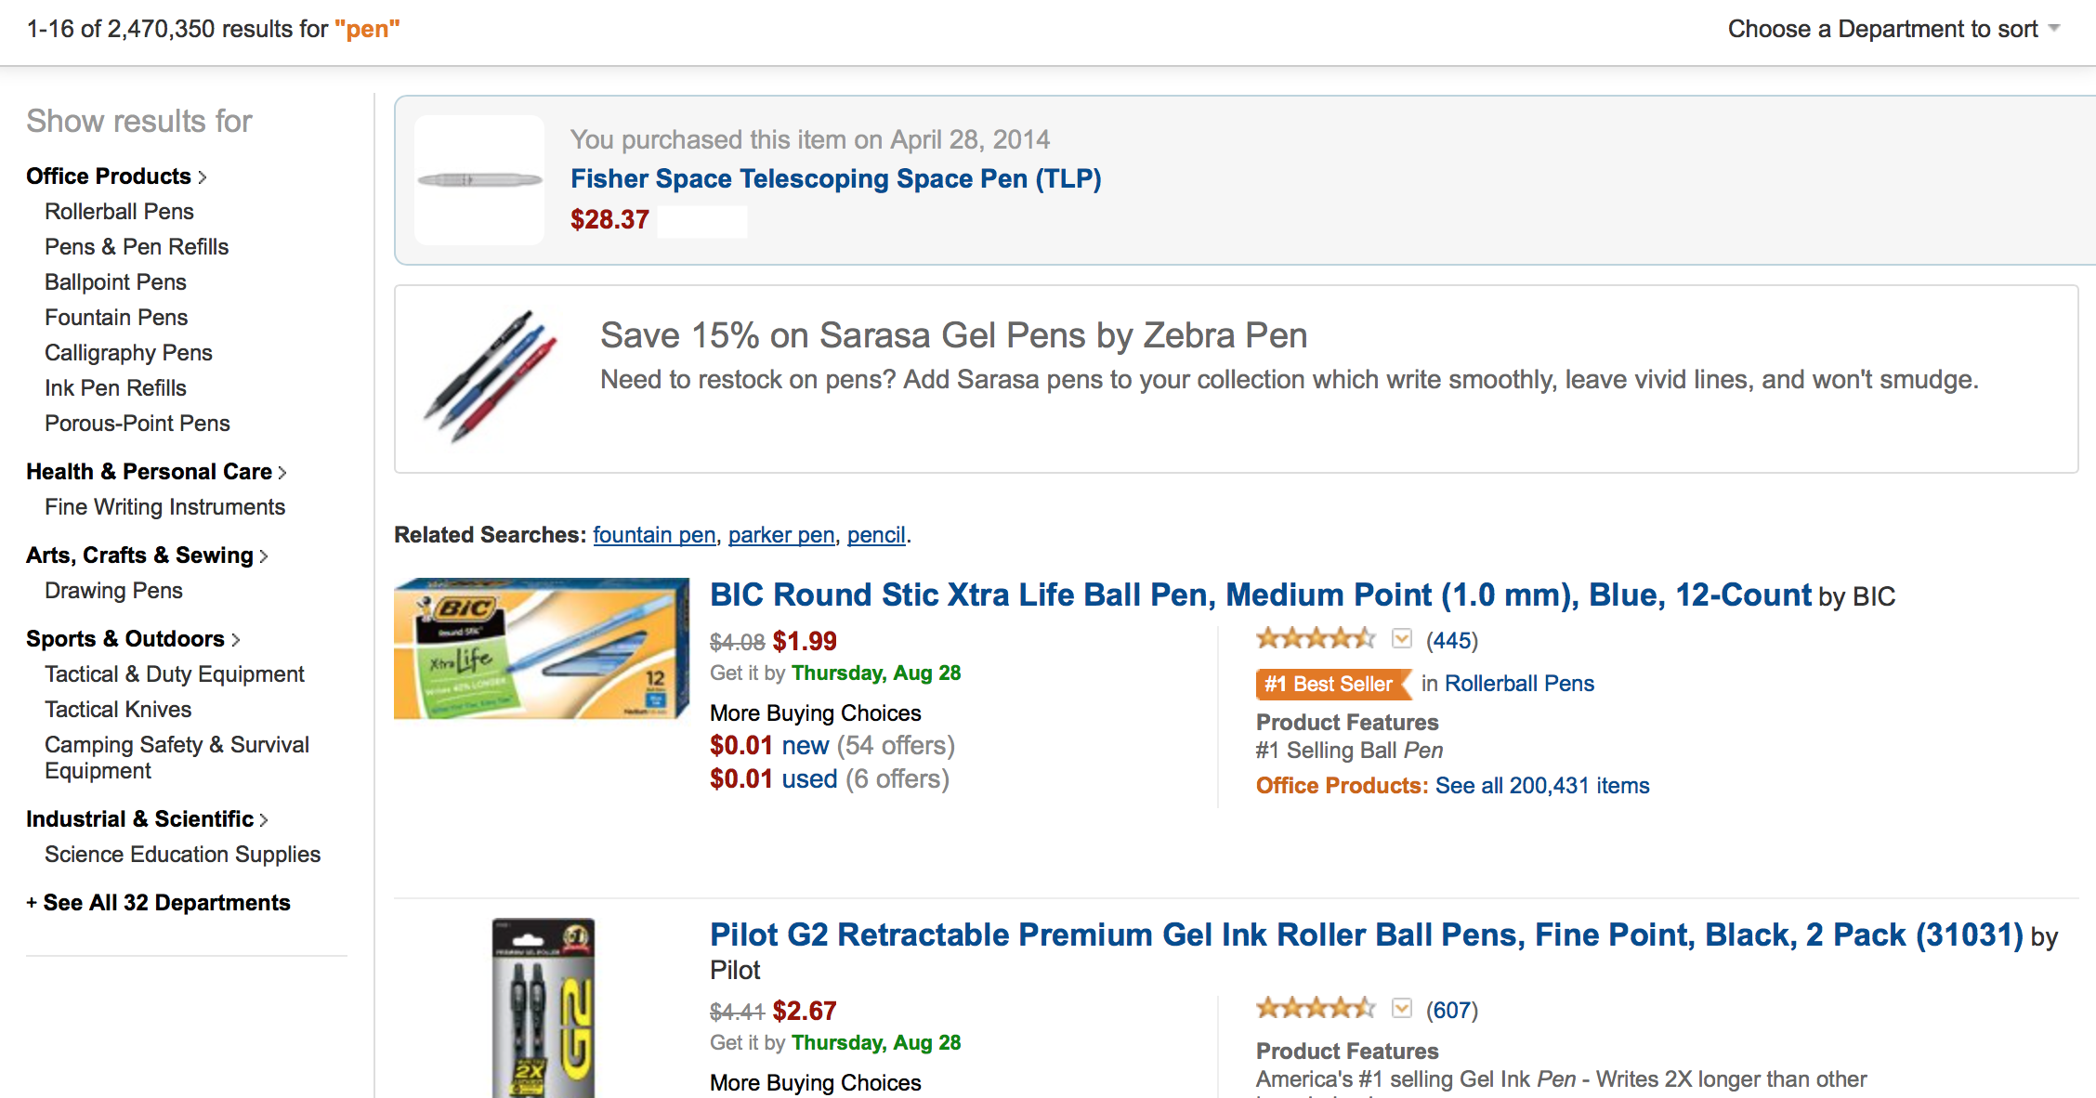
Product List
RESULTS_HEADER_COMPONENT
RESULTS_SIMILAR_PURCHASE COMPONENT
RESULTS_SALE COMPONENT
RESULT COMPONENT
RESULTS_
FILTER_BY_
DEPARTMENTS_
SIDEBAR COMPONENT
RESULT COMPONENT
RESULTS_LIST COMPONENT

Slide 6
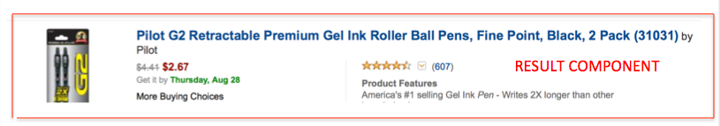
Name: RESULT Data: photo, result name, brand, prices, ship date, choices, stars/reviews, features Actions: clicks: on photo, result name, stars/reviews Configuration (content, images, etc.): result photo result name result brand result prices result ship date result buying choices result reviews/stars result features
Example (cont’d) Component definition

Slide 7
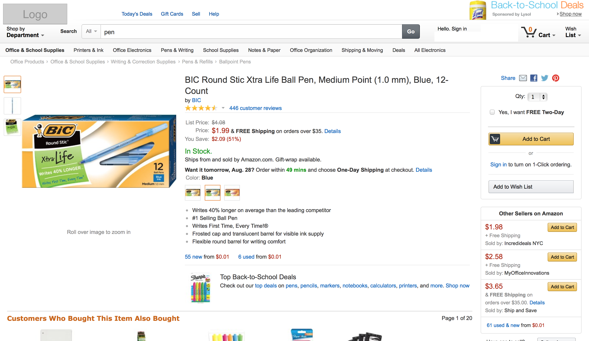
Product Details
HEADER_SEARCHBAR COMPONENT
SOCIAL COMPONENT
PRODUCT_IMAGE COMPONENT
CART_COMPONENT
PRODUC_DETAILS COMPONENT
RELATED_SALES COMPONENT
PRODUCT COMPONENT
OTHER_SELLERS_COMPONENT

Slide 8
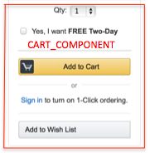
Name: CART Data: quantity (dropdown) free shipping (checkbox) Actions: select quantity (dropdown) select free shipping (checkbox) add to cart (button) sign in (anchor tag) add to wishlist (button) Configuration (content, images, etc.): select quantity (dropdown) select free shipping (checkbox) add to cart (button) sign in (anchor tag) add to wishlist (button)
Example (cont’d) Component definition

Slide 9
API Design for ATM Finder
Instructions
Using screenshots on slides 8 and 9, please define restful API with input and output schema for a simple search
Excludes advance search
Anything pass the search result page is out of scope

Slide 10
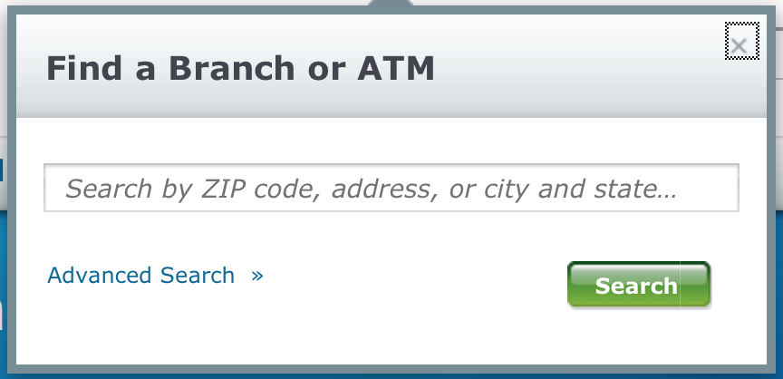
Simple Search

Slide 11
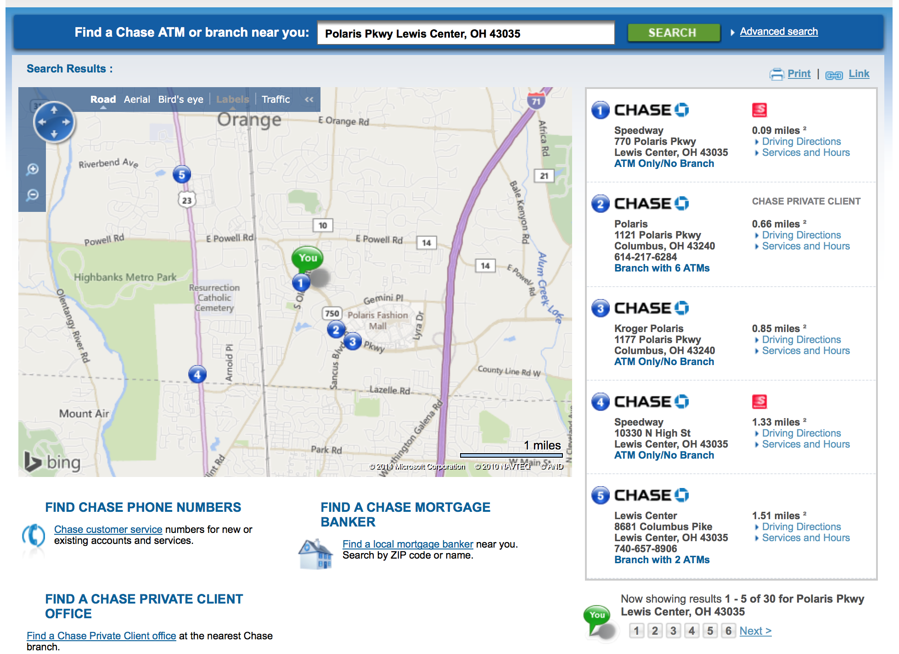
Search Results

Slide 12
